Slide 1
Chicago Real-Estate
Price Prediction
By Phillip Betts, Mary Kate Krusenoski, Yunhao Dou, Zijun Wu

Slide 2
Table of Contents
Executive Summary & Problem Statement
Data Exploration & Feature Engineering
Objective and Problem Statement
Methods and Decisions
Exploratory Data Analysis
Modeling & Methodology
Recommendations & Lessons Learned
Initial Insights
Tools Used
Findings and Conclusions

Slide 3
Executive Summary
Executive Summary:
Investigation: Examine how Covid-19 has affected the housing market based on projected price through current 2022 For Sale homes compared to what we would expect.
Industry:
Real estate - housing market price prediction
Business Problem:
As the price for real estate has inflated, we would like to determine if there are any current houses below or at market price based on RedFin data coupled with 12-month crime statistics.
Source: https://www.redfin.com/city/29470/IL/Chicago
https://www.redfin.com/news/data-center/
https://data.cityofchicago.org/Public-Safety/Crimes-2001-to-Present/ijzp-q8t2
Challenges:
We limited to only the past 6 years worth of data from Redfin based on manual downloading capabilities.
Using additional features (such as crime data) from another dataset and map those values using Location/Community Area.

Slide 4
General Data Information
RedFin Dataset: Homes sold in the Chicagoland area from 2016-2022
Size: 81,027 Total Rows
Features: Sale Type, Sold Date, Property Type, Address, City, State or Province, Zip or Postal Code, Prie, Beds, Baths, Location, Square Feet, Lot Size, Year Built, Days on Market, $/ Square Feet, HOA /Month, Status,Open House Start Time, Open House End Time, URL, Source, MLS #, Favorite, Interested, Longitude, Latitude
Chicago Crime Dataset: Chicago crime incidents reported from 2016-2022
Size: 211,337 Total Rows
Features: ID, Case Number, Block, IUCR,Primary Type, Description, Location Description, Arrest, Domestic, Beat, District, Ward,Community Area, FBI Code, X Coordinate, Y Coordinate, Year, Updated on, Latitude, Longitude, Domestic

Slide 5
01
Data Exploration & Feature Engineering

Slide 6
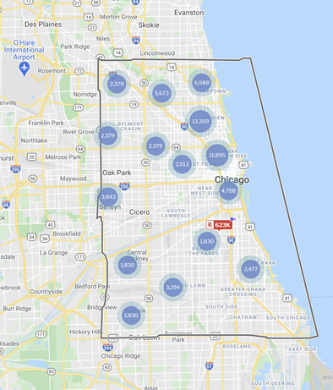
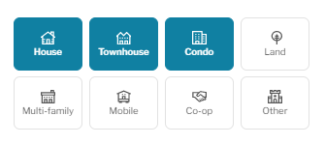
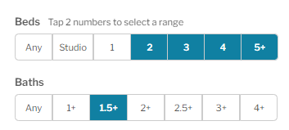
Redfin Data Procurement
Source: https://www.redfin.com/city/29470/IL/Chicago
MANUALLY DRAWN BORDERS
Borders set to popular areas our group, peers, friends and family deem “Chicago”
DEFINED PROPERTY ATTRIBUTES
Average Home-buyers look for
House, Townhouse, or Condo Property Types
Minimum 2 Beds
Minimum 1.5 Baths

Slide 7
Feature Selection
Initial Features
Final Features
SALE TYPE
SOLD DATE
PROPERTY TYPE
ADDRESS
CITY
STATE OR PROVINCE
ZIP OR POSTAL CODE
PRICE
BEDS
BATHS
LOCATION
SQUARE FEET
LOT SIZE
YEAR BUILT
SOLD DATE
PROPERTY TYPE
CITY
ZIP OR POSTAL CODE
PRICE
BEDS
BATHS
LOCATION
SQUARE FEET
YEAR BUILT
HOA/MONTH
LATITUDE
LONGITUDE
Aggregate Crimes
DAYS ON MARKET
$/SQUARE FEET
HOA/MONTH
STATUS
NEXT OPEN HOUSE START TIME
NEXT OPEN HOUSE END TIME
URL (SOURCE
MLS#
FAVORITE
INTERESTED
LATITUDE
LONGITUDE
Aggregate Crime
We finalized features for model building based on which features had sufficient sample size, intuitively seemed strong predictors, and had strong correlations to price

Slide 8
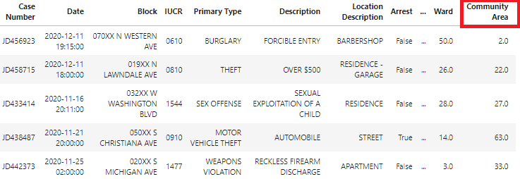
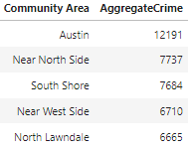
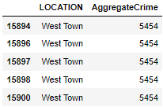
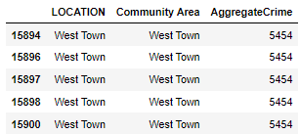
Combining Crime Data
Purpose: Chicago Crime rate is a popular discussion topic so we thought adding the data would help improve accuracy
Transformed Numeric Community Area Codes to Community Names
Aggregated Crime Volume by Community Name
*Mapping provided by Crime Chicago Site
Drop Community Area
Merged data on Community Area and Redfin LOCATION

Slide 9
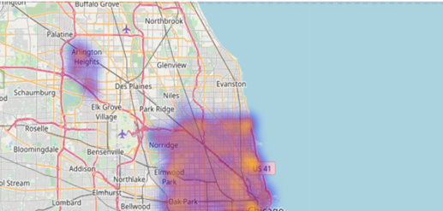
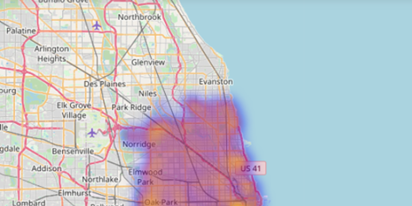
Data Cleaning
Remove Arlington Heights Data
Redfin added in Arlington Heights Housing data regardless of previously stated bordering

Slide 10
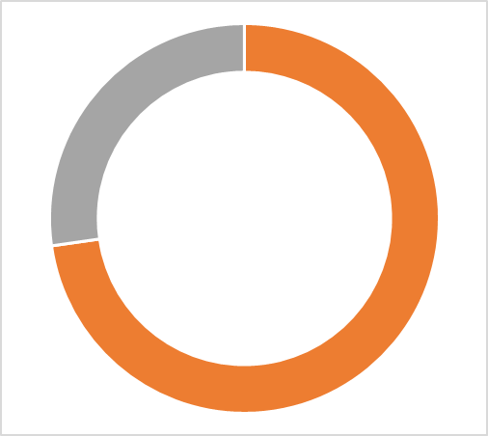
Data Cleaning
All Data
81,027
Final Volume
58,950
Removing Errors, Outliers and Missing data
Remove Property Types not in “Single Family Residential, Condo/Co-op, and Townhouse
Dropped Duplicates
Drop Null Latitude data
Remove Longitudes with zero (0) value
Remove Outlier Square Footage
Less than 176
Greater than 9999
Remove Houses with 42 baths
Remove PRICE Outliers
22,077
27%
73%
58,950
73% (58,950) of Data left after cleaning

Slide 11





Feature Engineering
Encoding Categorical Values
Imputing Missing Values
KNN
Categorical Features
City
Date Values
Square Feet
HOA/Month
Crime Date
Changed Categorical features (Property Type, City, Location,Zip or Postal Code, Year Built) to Numeric Values
Since Chicago accounts for 75% of data and has a different tax bracket for property, we made the feature binary
We replaced Date values with consecutive integers for easier categorization
We used a KNN impute to replace Missing Square Feet. We assumed those with similar features likely had similar Square Footage
We assume any Property that did not have a listed HOA likely didn't have one
The only areas unmapped were outside of the Chicago Area. We decided to fill values with median

Slide 12
02
Exploratory Data Analysis

Slide 13
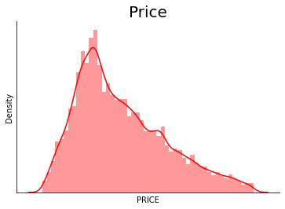
Price has a Small Positive Skew
Taking the log of price produced a larger negative skew, so we did not transform price.
Skew: 0.69

Slide 14
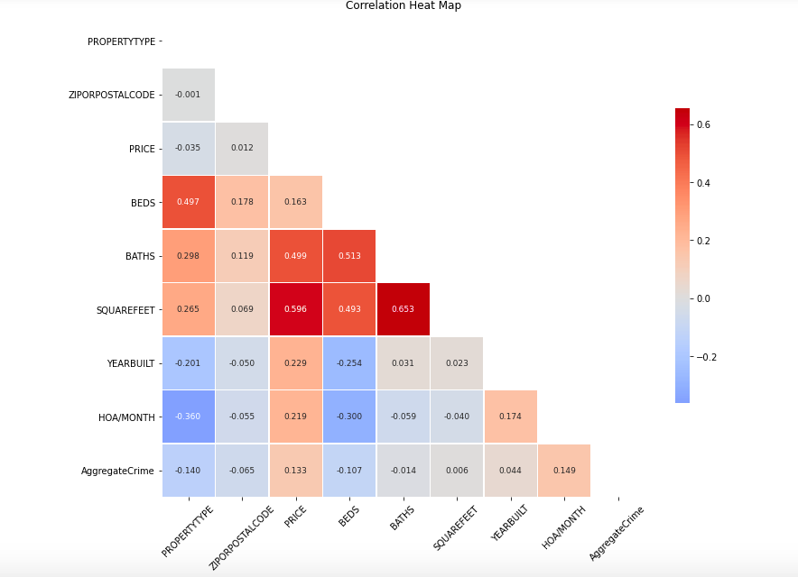
Square Feet and Baths are moderately correlated with our target variable price

Slide 15
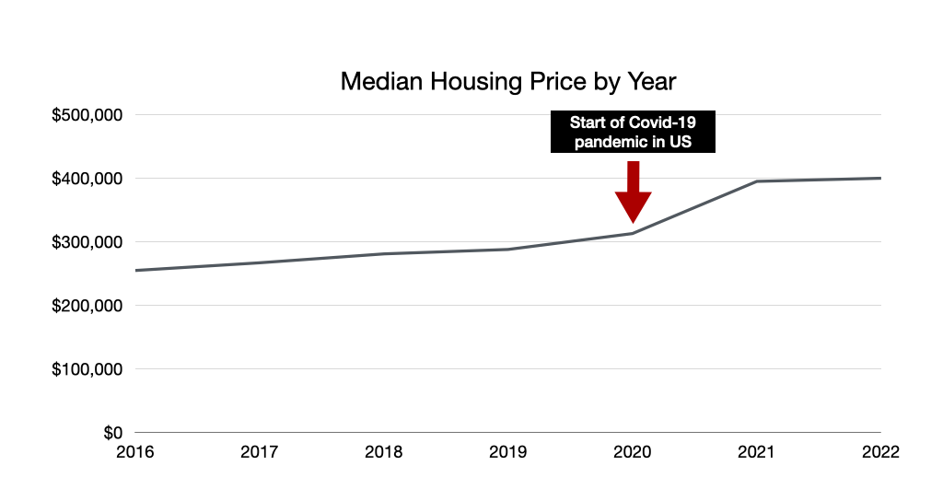
Median Housing Price has increased significantly since the Covid-19 Pandemic

Slide 16
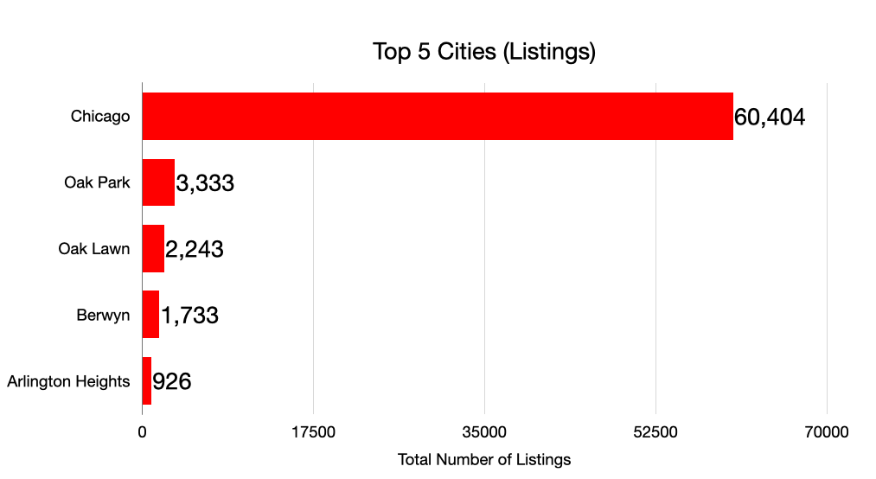
Listings in Chicago Dominate the Dataset

Slide 17
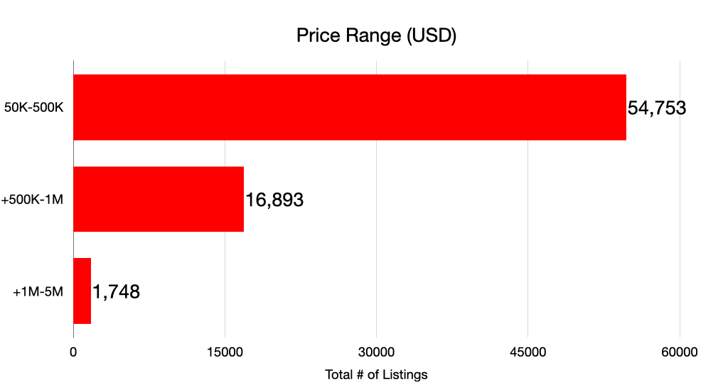
The Majority of Listings are listed for $500,000 or less

Slide 18
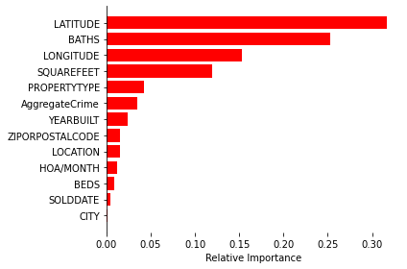
Feature Importance
Key Takeaways
Latitude and Longitude (Location, Location, Location!) accounted for almost 50% of relative importance
Baths surprisingly was a significant predictor
Squarefeet was also a good predictor considering its correlated with price
*Based on Decision Tree Model (81% RMSE Score)

Slide 19
03
Modeling & Methodology

Slide 20
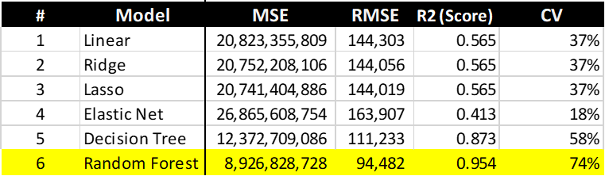
Model Evaluation
Random forest has the best performance on prediction power
Elastic Net has the lowest performance on CV
Lasso has the lowest performance on error matrix

Slide 21
04
Conclusion & Lessons Learned

Slide 22
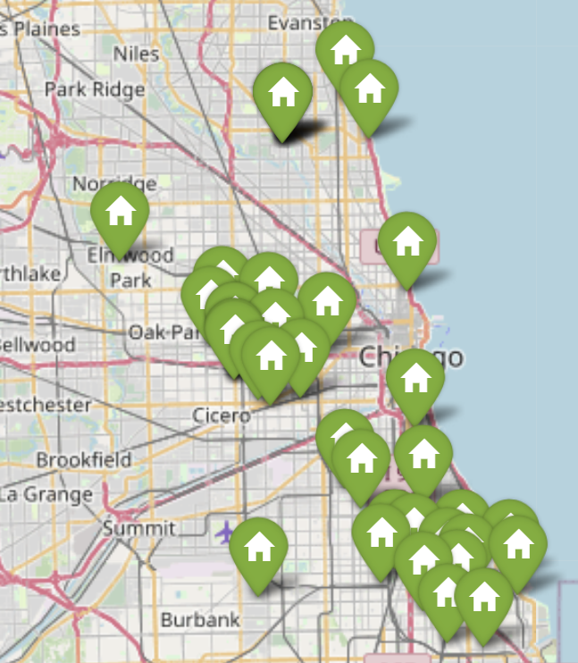
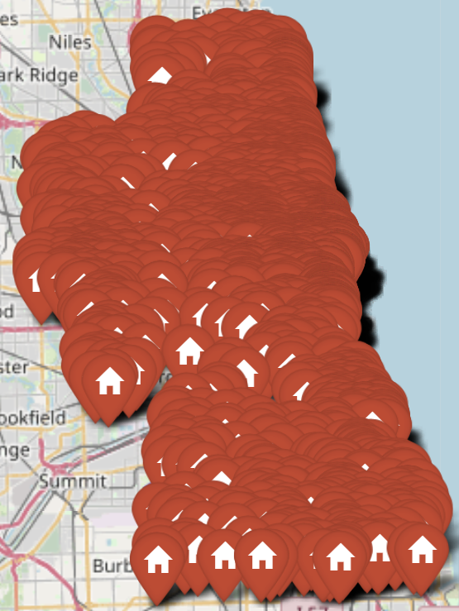
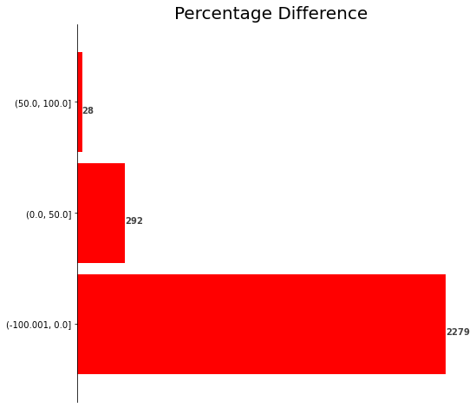
For Sale Data
Total 2,599 properties
2,279 properties are overpriced based on our model
320 properties were underpriced
Not a good time to buy!
Actual vs Predicted Price

Slide 23
Recommendation & Conclusion
We recommend using ‘Random Forest’ model to forecast the target variable housing price
Random forest has the best prediction power out of all other models
Has the lowest RMSE score of 94732 and accuracy score of 94%
We may need to trim our dataset time window for better prediction results.
Our housing data covers a 6 year time window, from 2016 to 2022.
During this time window, covid strike the house market during 2019 to 2021, causing the fluctuations and abnormally patterns in housing price
As a result, our data points are separated far from each other, resulting in large error matrices
Additional data to lower down error matrix
House price are very volatile and very random, and is often influenced by external factors (or news) such as currency regulations, or investments preferences.
We need additional data from news or social media to make these models perform better and more accurately.

Slide 24
Lessons Learned
Data cleaning took a significant portion of the work.
It was imperative that we removed outliers from the dataset to reduce noise and control for overfitting / underfitting.
Using different jupyter notebooks raised a challenge when trying to collaborate models.
It was surprising to see how poorly linear regression performed compared to a decision tree model on error matrix.
Time window or stepwise prediction could be significant factors to consider before building our models.

Slide 25
Q & A

